Slide 1
Surface reconstruction from models for subtractive manufacturing simulation
Bernhard Manfred Gruber 2015-05-07

Slide 2
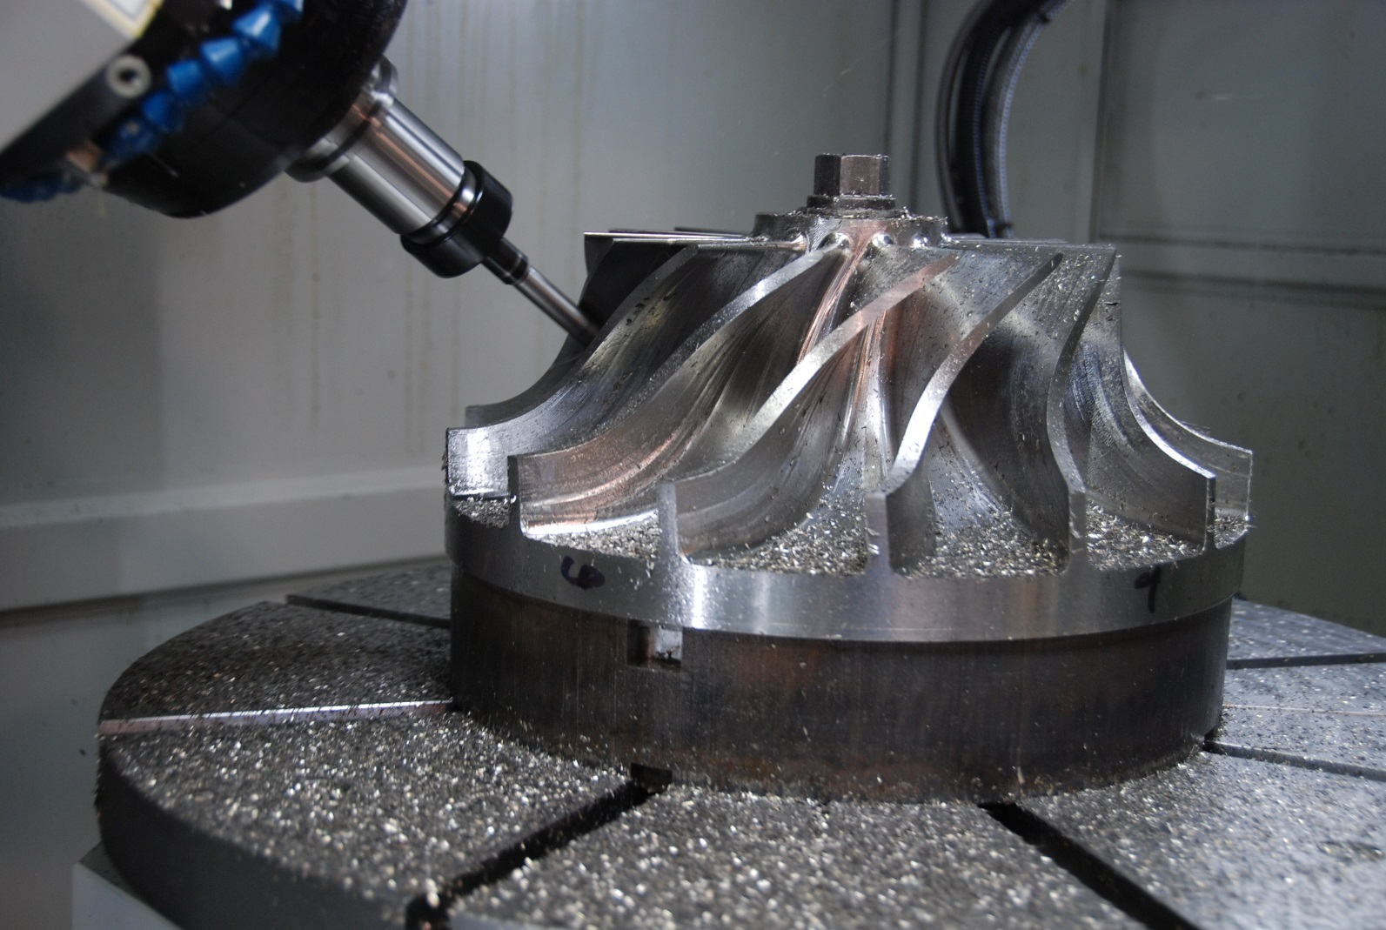
Subtractive manufacturing
http://www.hurco.com/IN/why-hurco/success-stories/blog/PublishingImages/nuconvmx42sr%20cutting.JPG

Slide 3
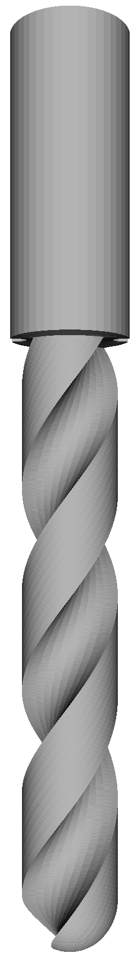
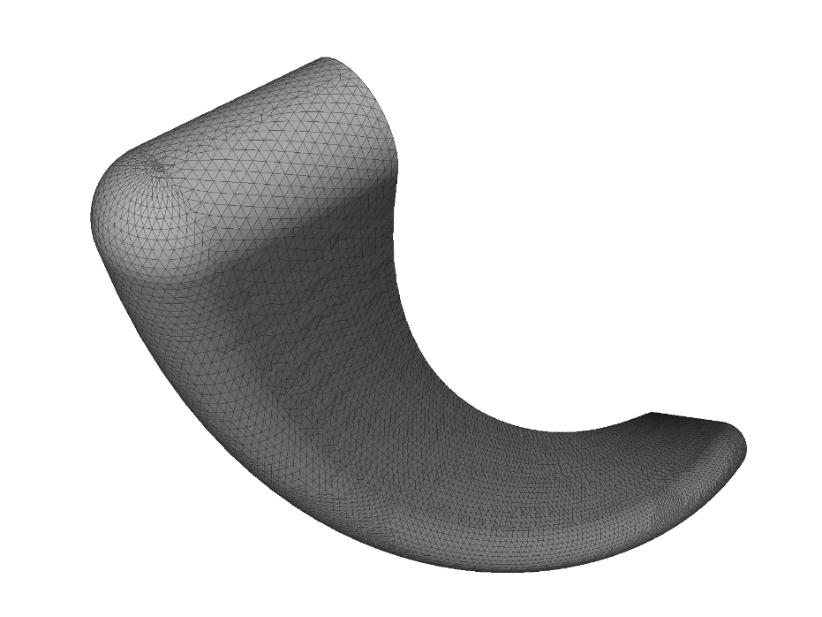
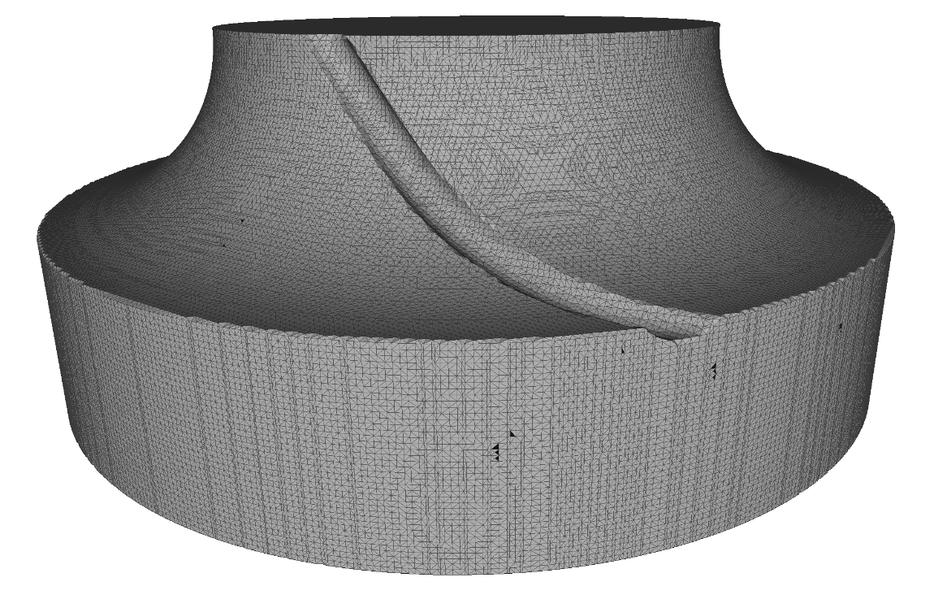
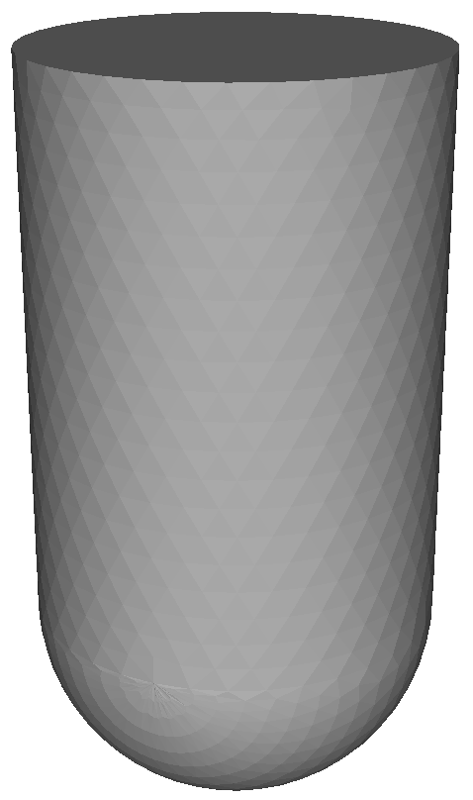
Subtractive manufacturing simulation

Slide 4




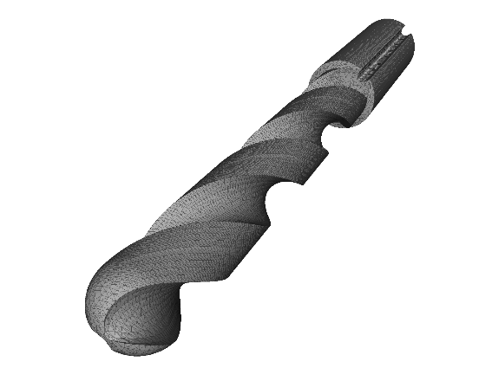
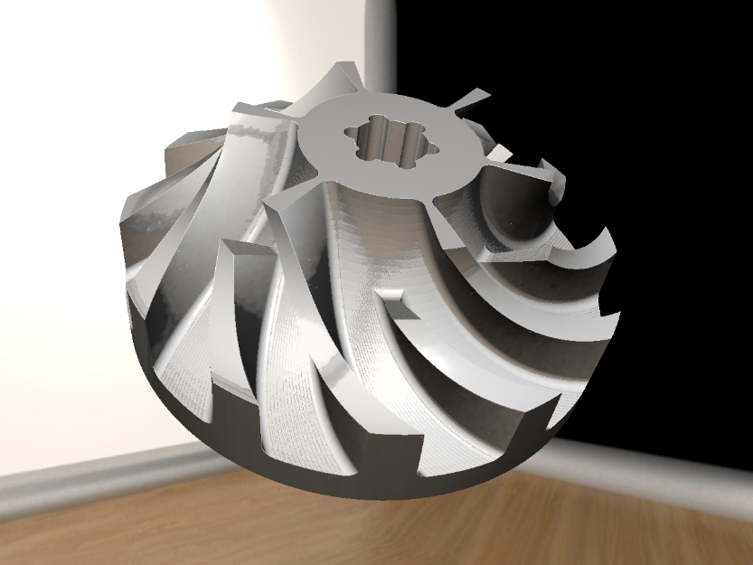
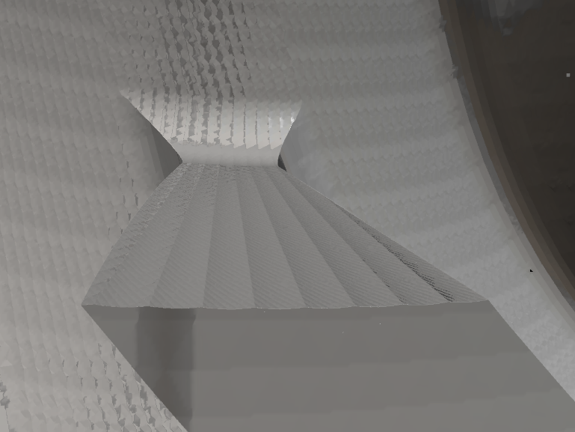
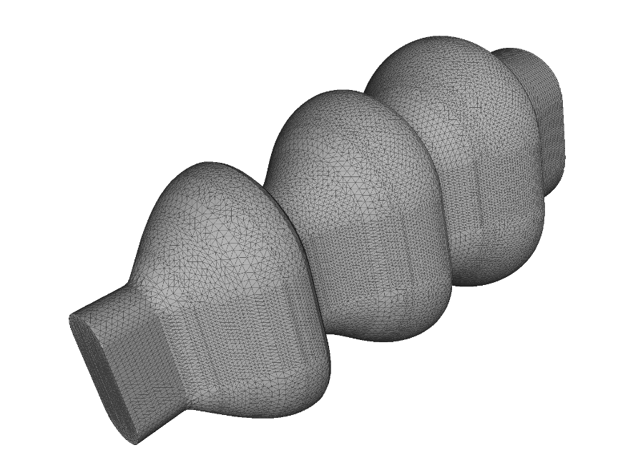
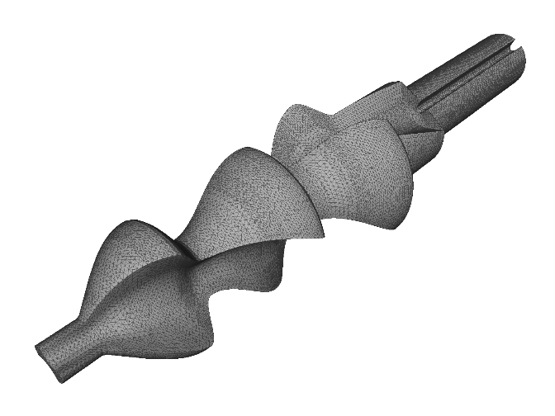
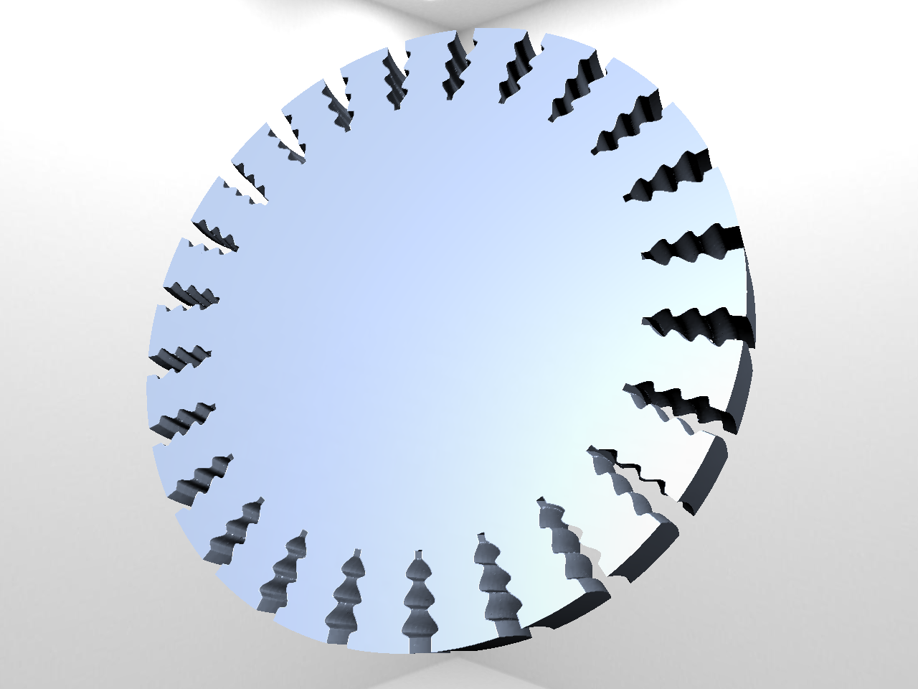
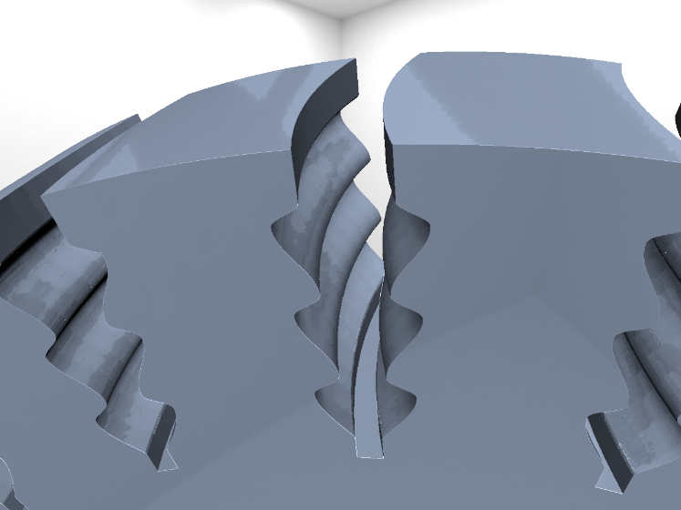
Previous work – VML

Slide 5
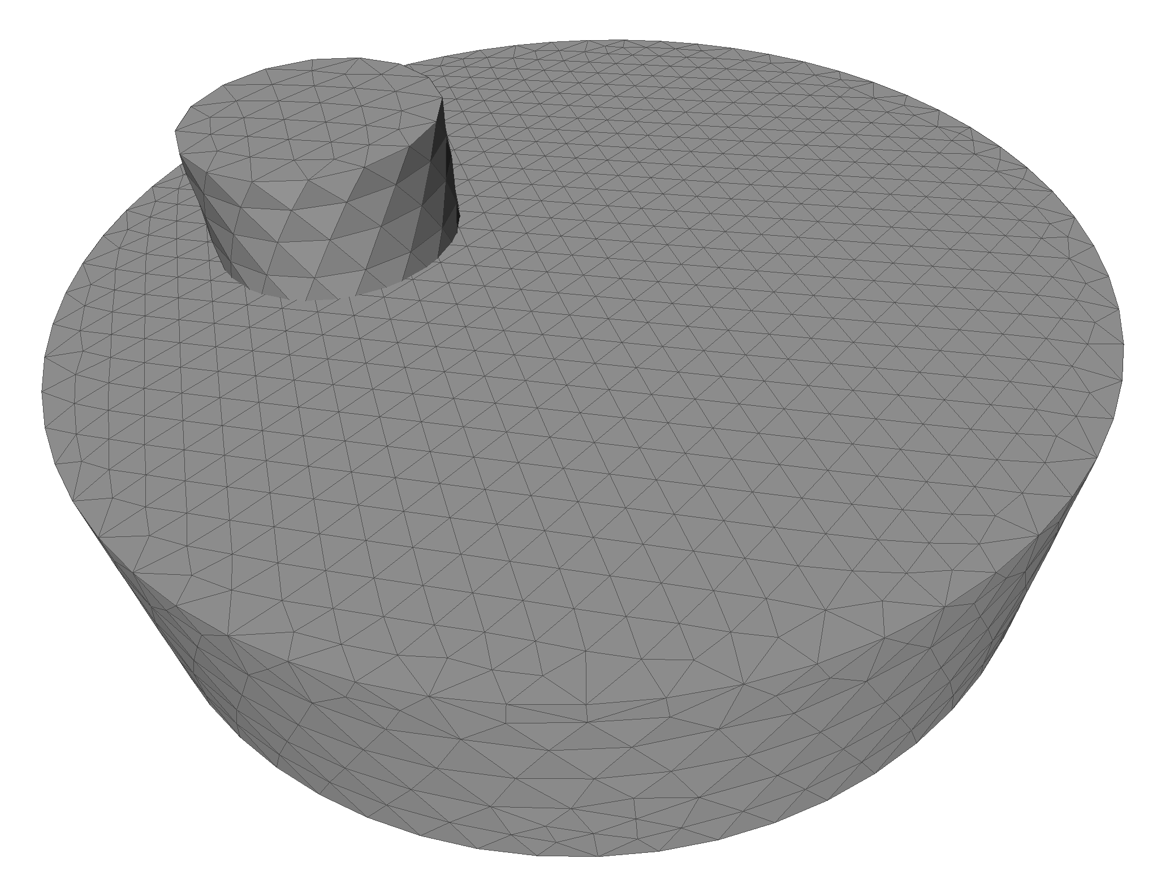
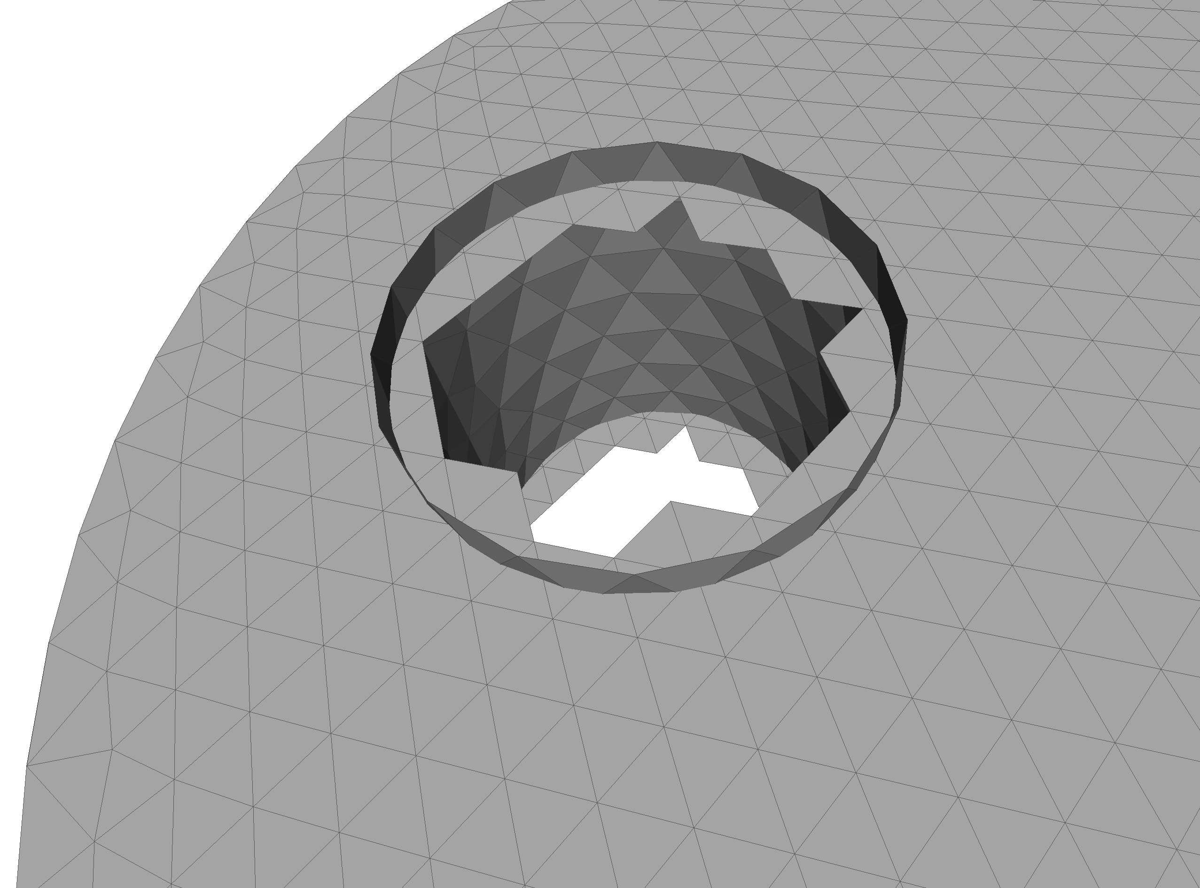
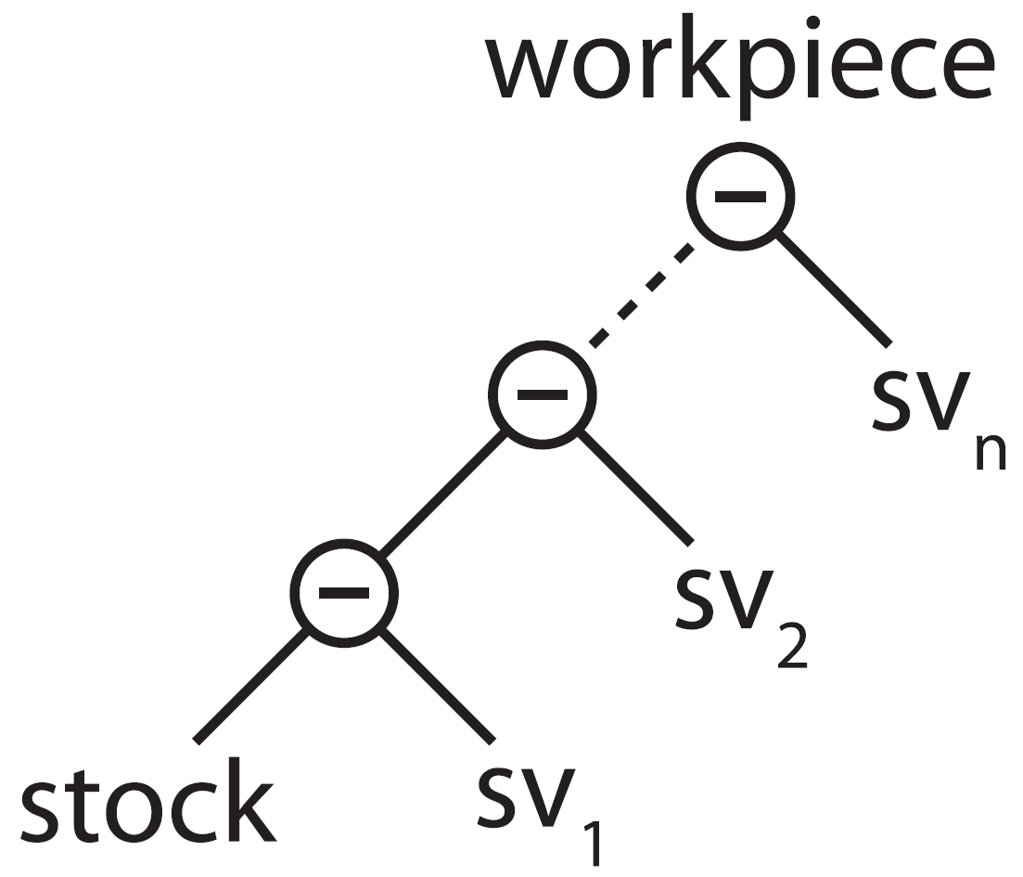
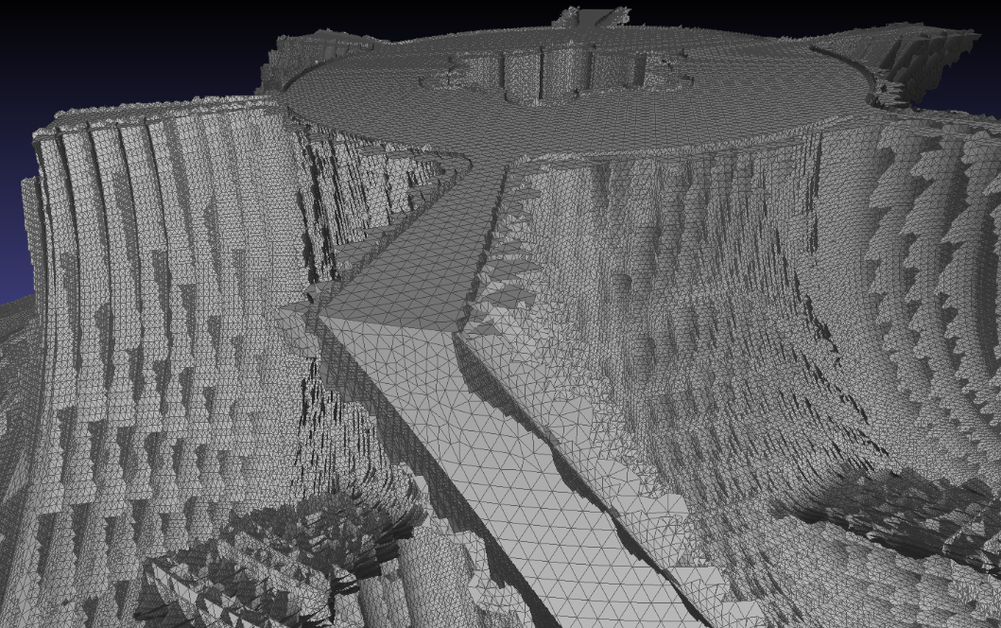
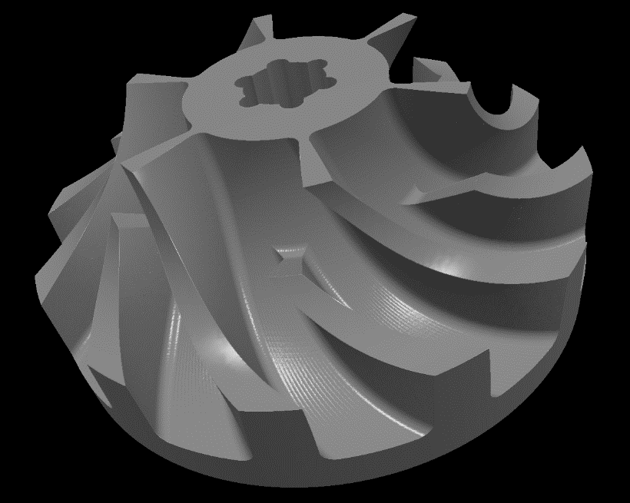
VML data model

Slide 6
Problem statement
Extract triangulated surface from VML data model
Determine state of the art
Prototypic implementation and comparison
runtime, memory, complexity, visual quality, errors, divergence, numeric, mesh quality, feature conservation, adaptivity
Testing on selected scenes
Is there a "best" algorithm? Under which circumstances? How to select best suited algorithm?

Slide 7
Approaches
Direct intersection of swept volumes
Most naïve, theoretically most accurate
Point cloud based
Point cloud easy to create using raycast
Reconstruction already implemented in swept volume computation
Dexel based
Dexel images easy to create using raycast
Implicit function and voxel based
VML already uses a voxel grid

Slide 8
State of the art

Slide 9
Direct intersection
David Rosen, Seamless Intersection Between Triangle Meshes, 2008

Slide 10
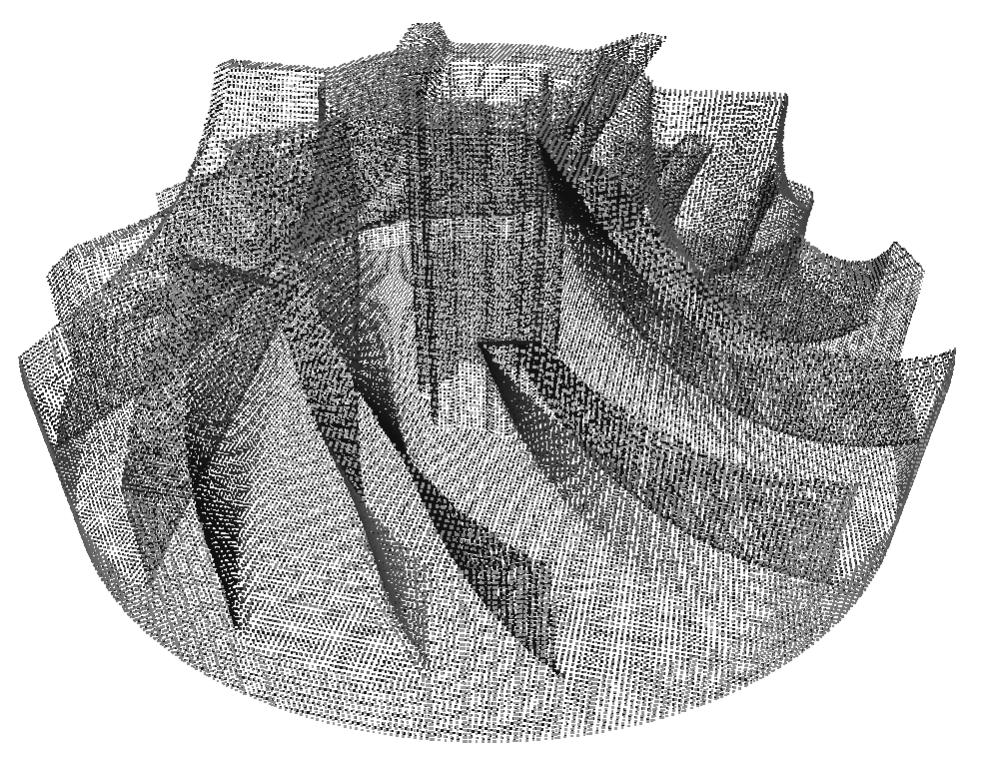
Point cloud based
α-shapes
Delaunay and Voronoi:
Crust and powercrust
Cocone, tight cocone and robust cocone
Region growing:
BPA, G2S
Notes:
A vast amount of algortihms available.
Point cloud reconstruction is a huge topic:
e.g. laser scans of sculptures or building

Slide 11
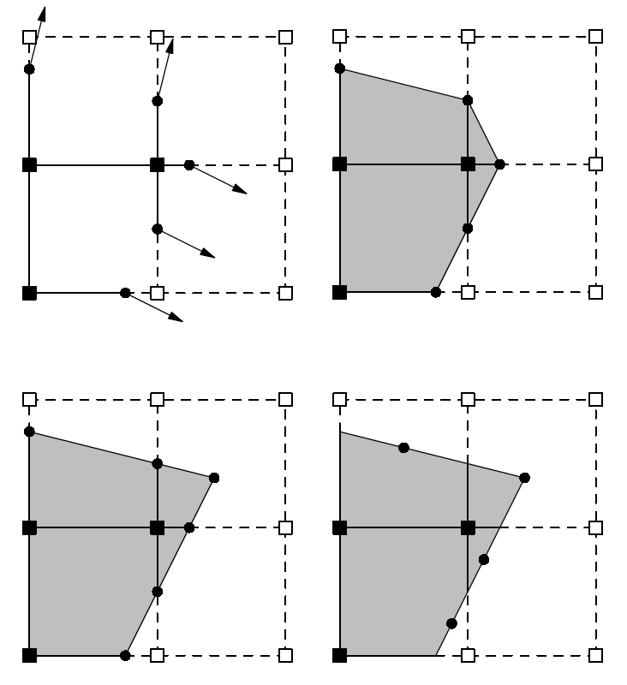
Implicit function and voxel based
Describe surface by a function, sampled at a regular grid
SDF, Hoppe, Poisson, MLS, RBF
Leif Kobbelt et al., Feature sensitive surface extraction from volume data, 2001
Tao Ju et al., Dual contouring of hermite data, 2002

Slide 12
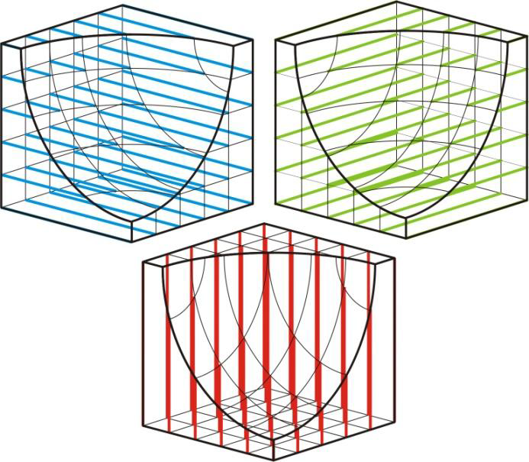
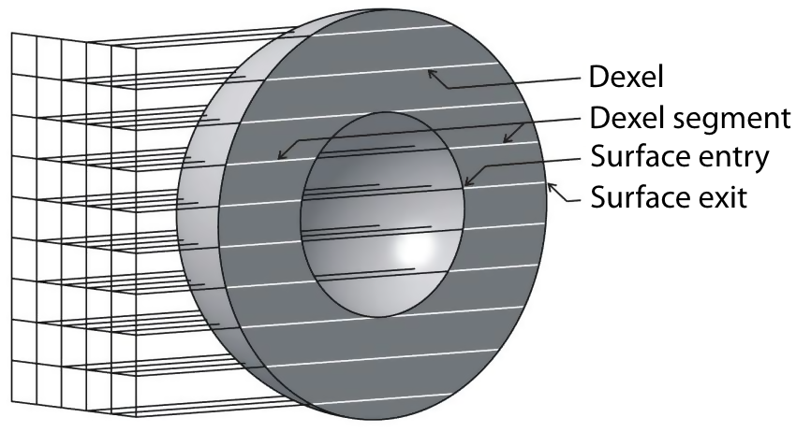
Dexel based
Yongfu Ren et al., Feature conservation and conversion of Tri-dexel volumetric models to polyhedral surface models for product prototyping, 2008

Slide 13
Implementations

Slide 14
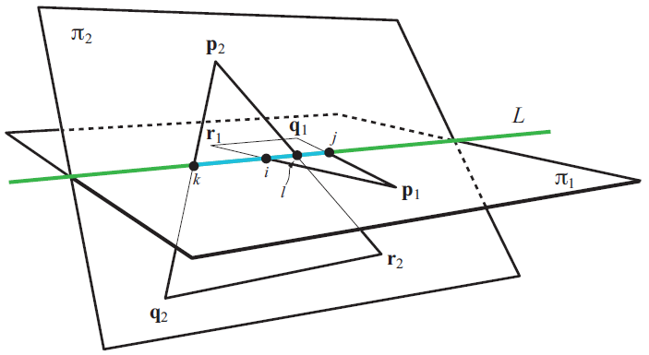
Direct triangle triangle intersection
Tomas Möller, A fast triangle-triangle intersection test, 1997
http://lib.znate.ru/docs/index-40240.html?page=3

Slide 15
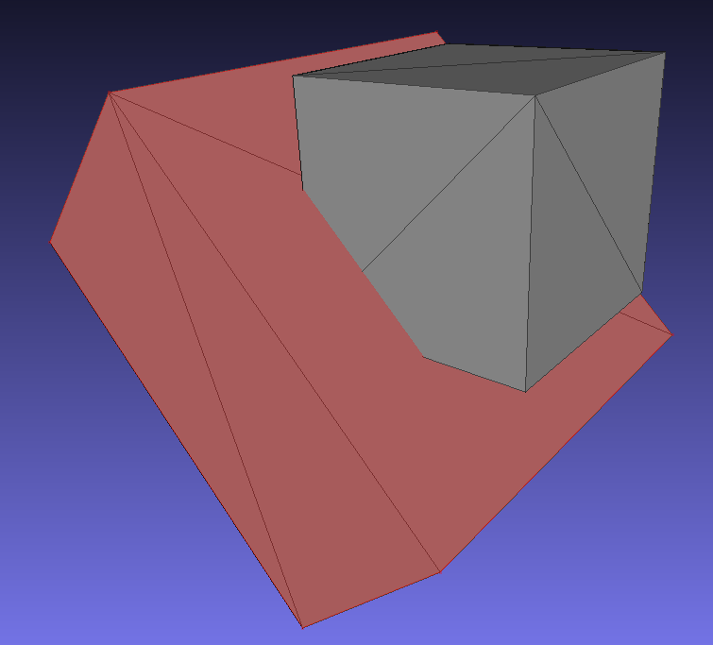
Cube vs. cube

Slide 16
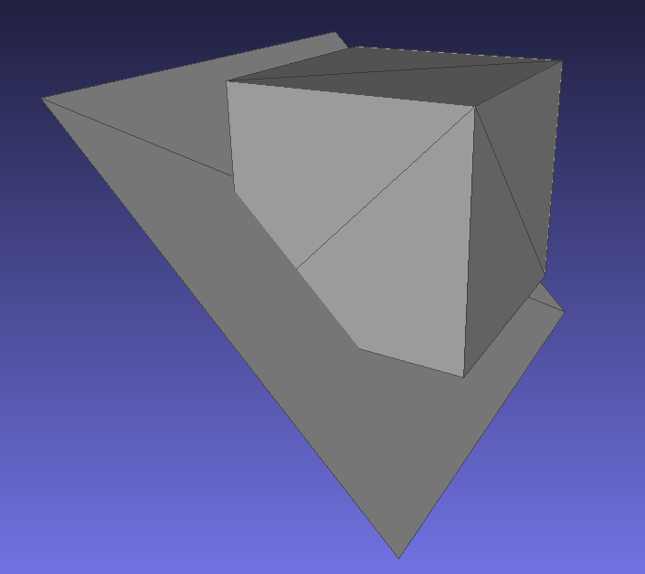
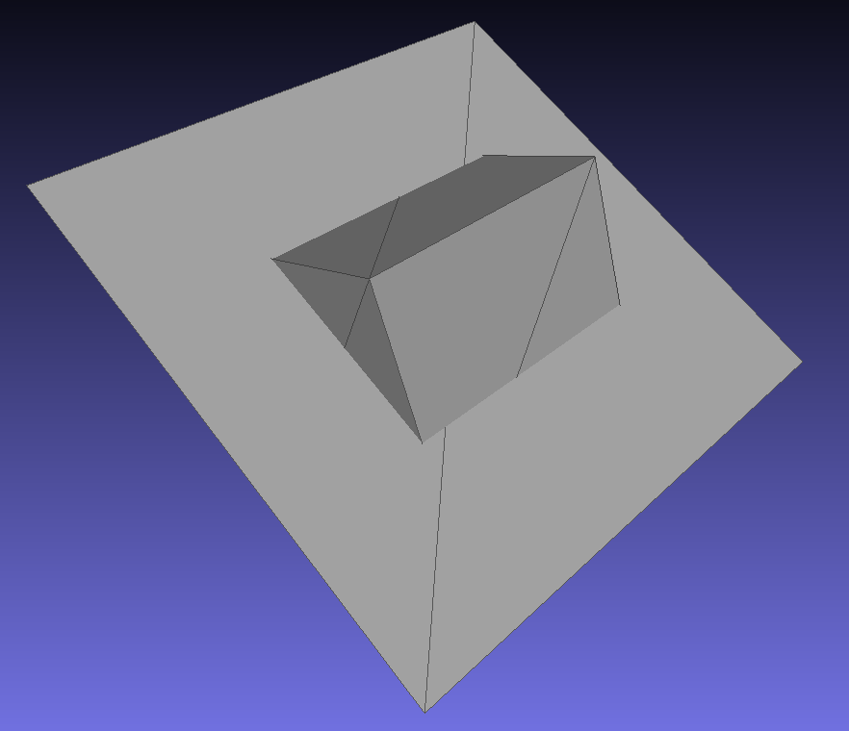
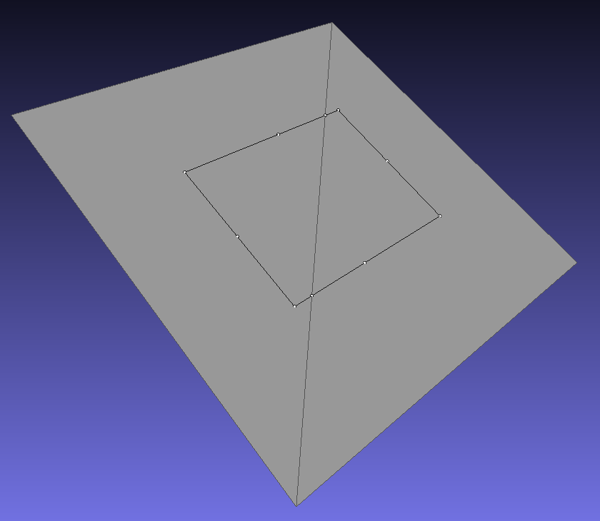
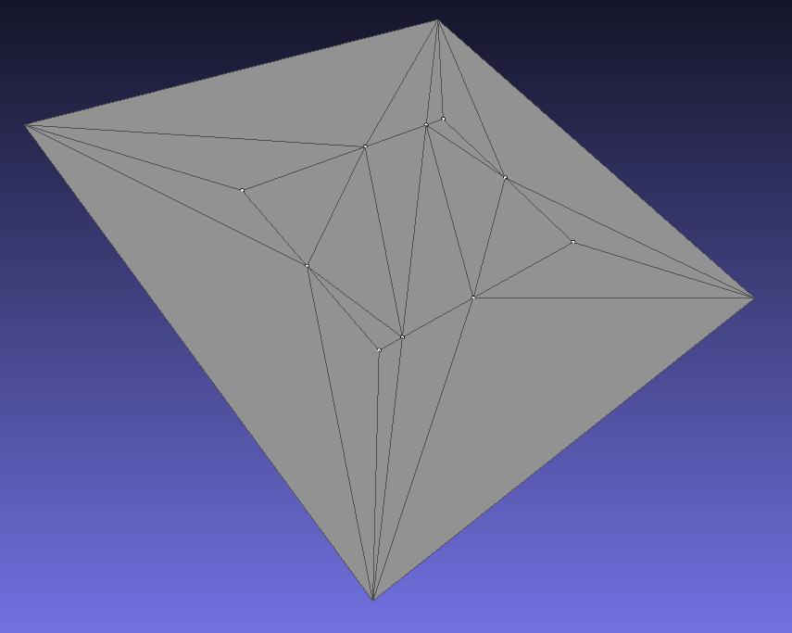
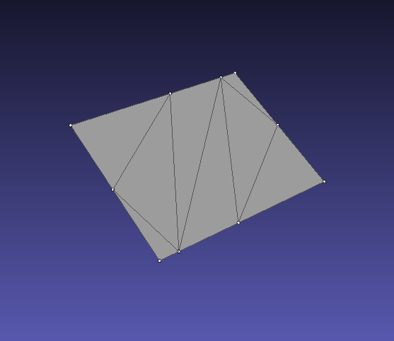
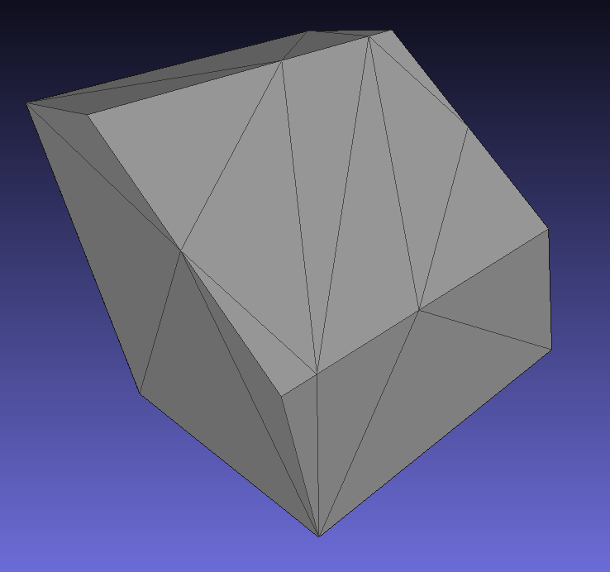

Slide 17
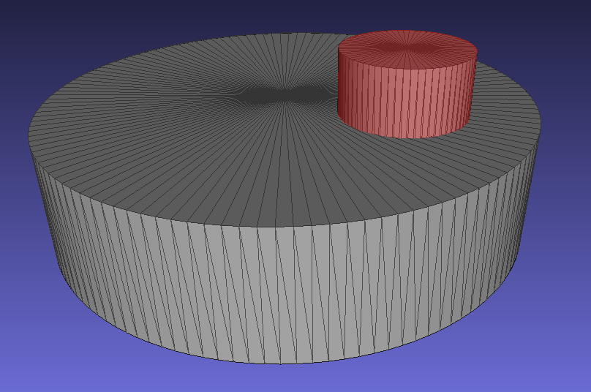
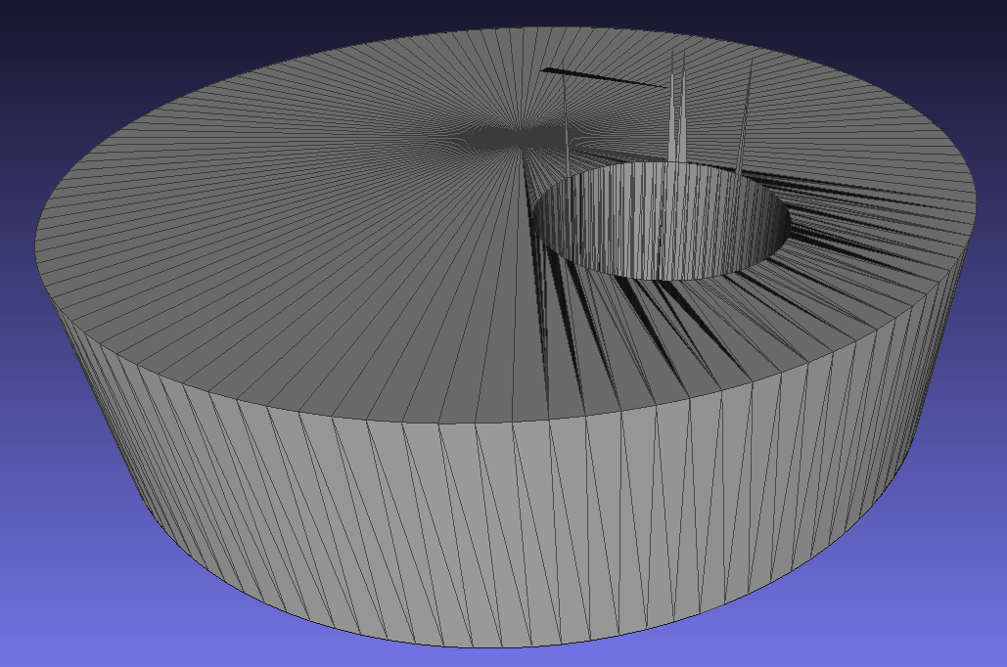
Cylinder vs. cylinder

Slide 18
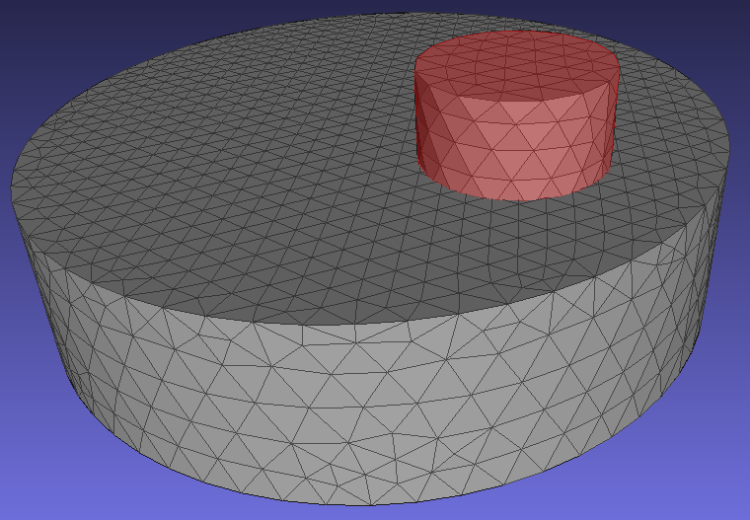
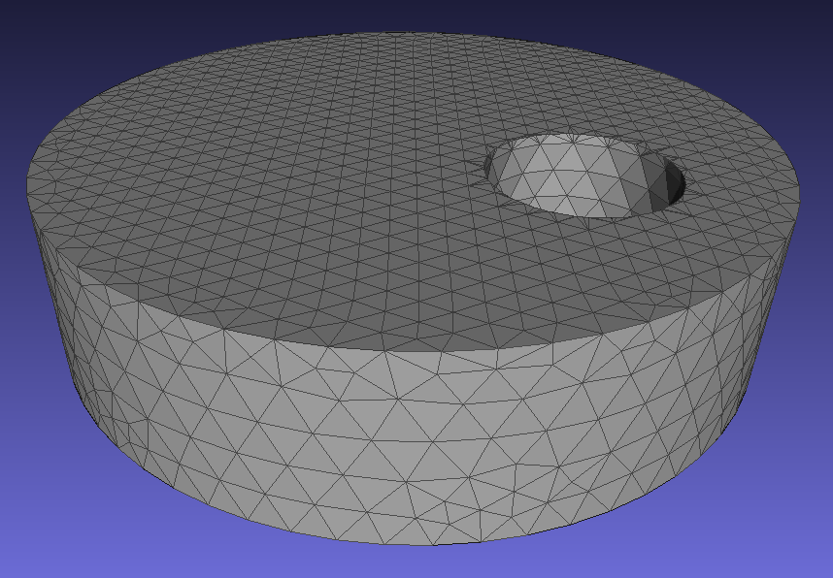
Cylinder vs. cylinder - Delaunay

Slide 19
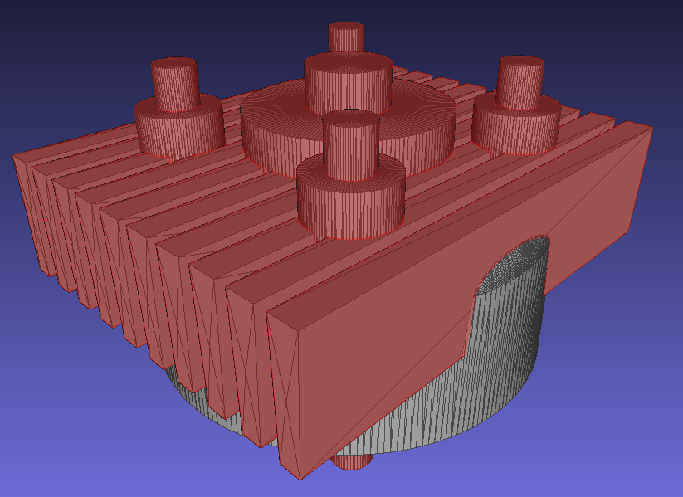
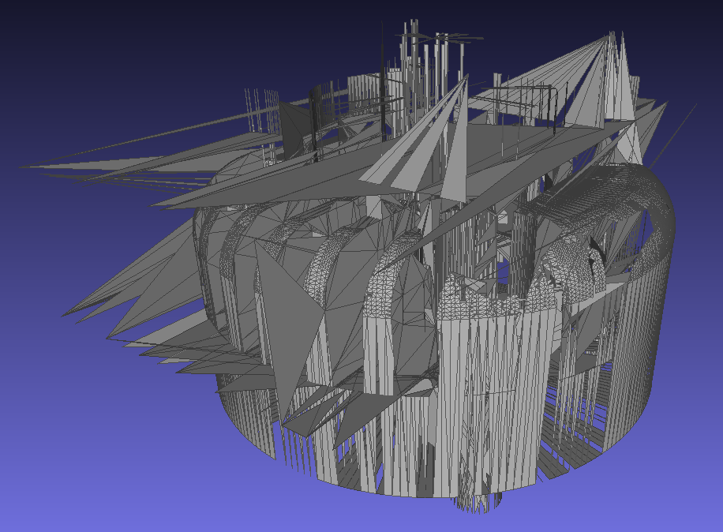
Cylinder head

Slide 20
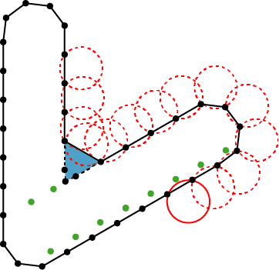
Ball pivoting algorithm
Fausto Bernardini et al., The ball-pivoting algorithm for surface reconstruction, 1999

Slide 21
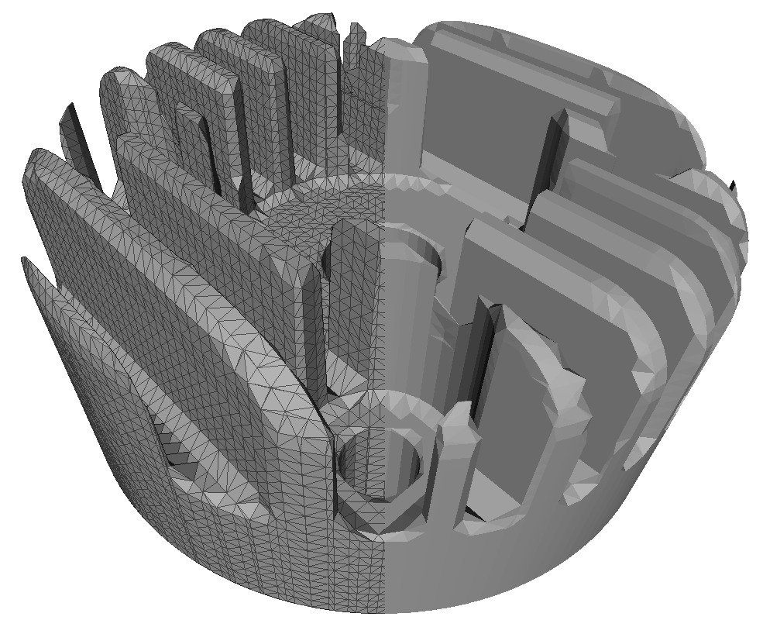
Cylinder head

Slide 22
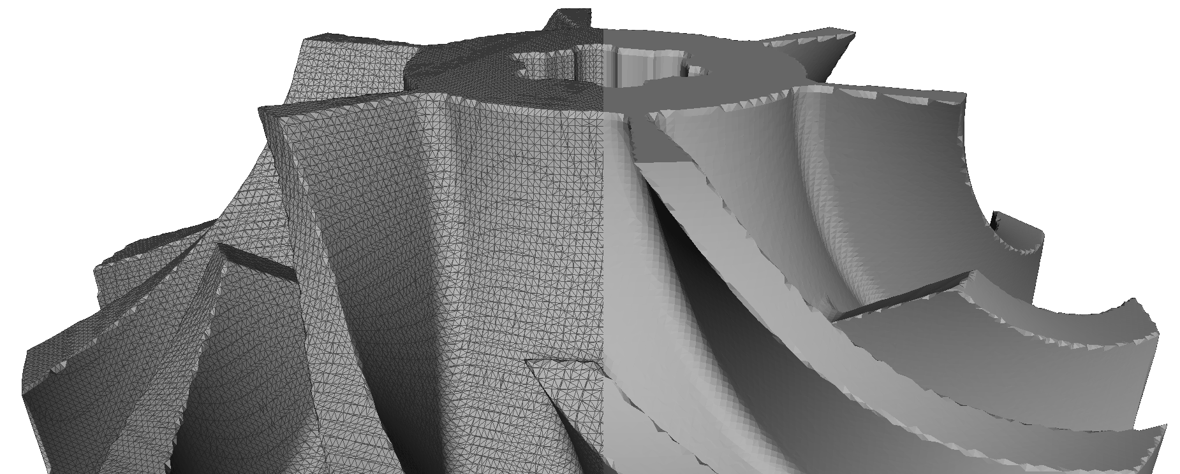
Impeller

Slide 23
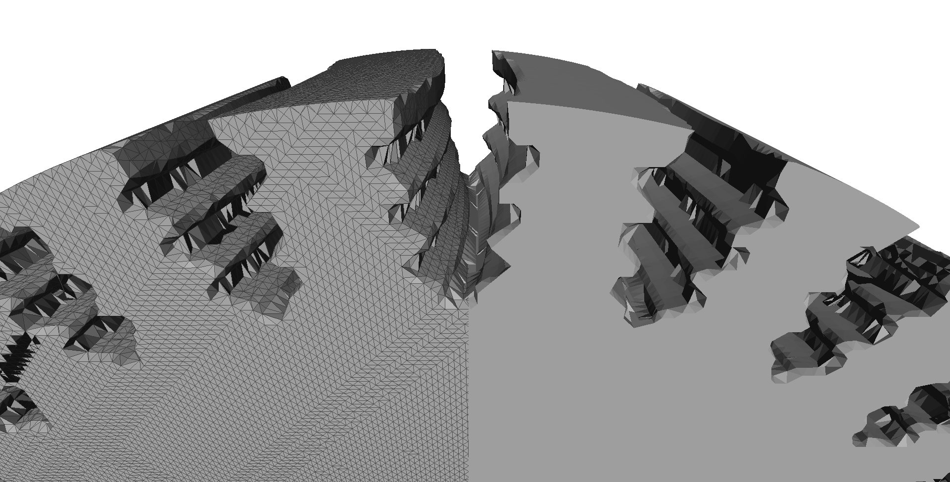
Turbine wheel

Slide 24
Tri-dexel
Yongfu Ren et al., Feature conservation and conversion of Tri-dexel volumetric models to polyhedral surface models for product prototyping, 2008

Slide 25
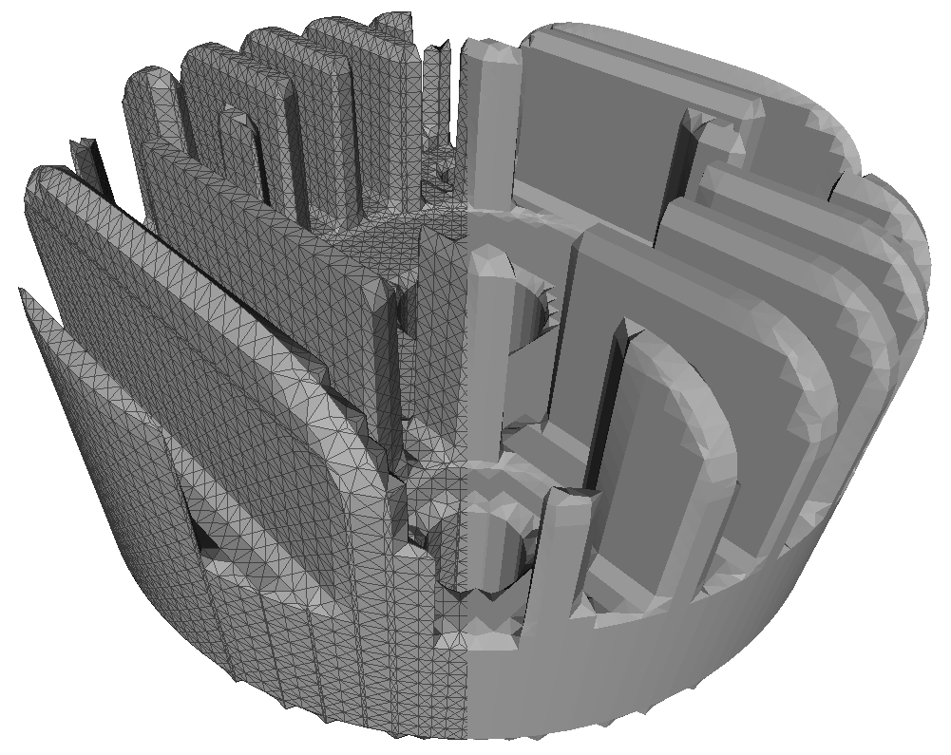
Cylinder head

Slide 26
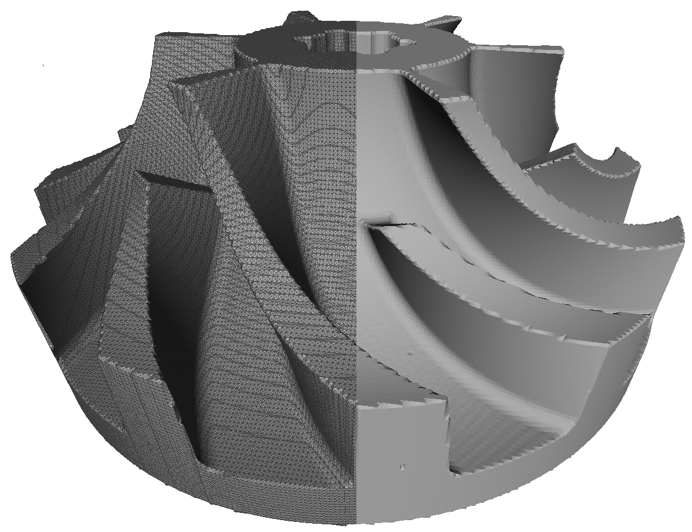
Impeller

Slide 27
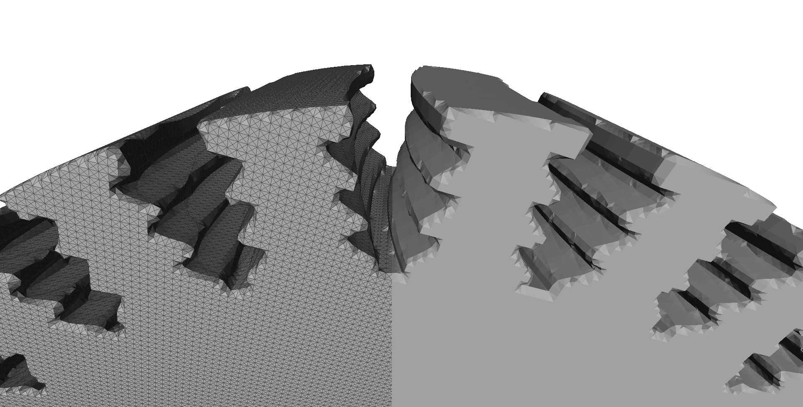
Turbine wheel

Slide 28
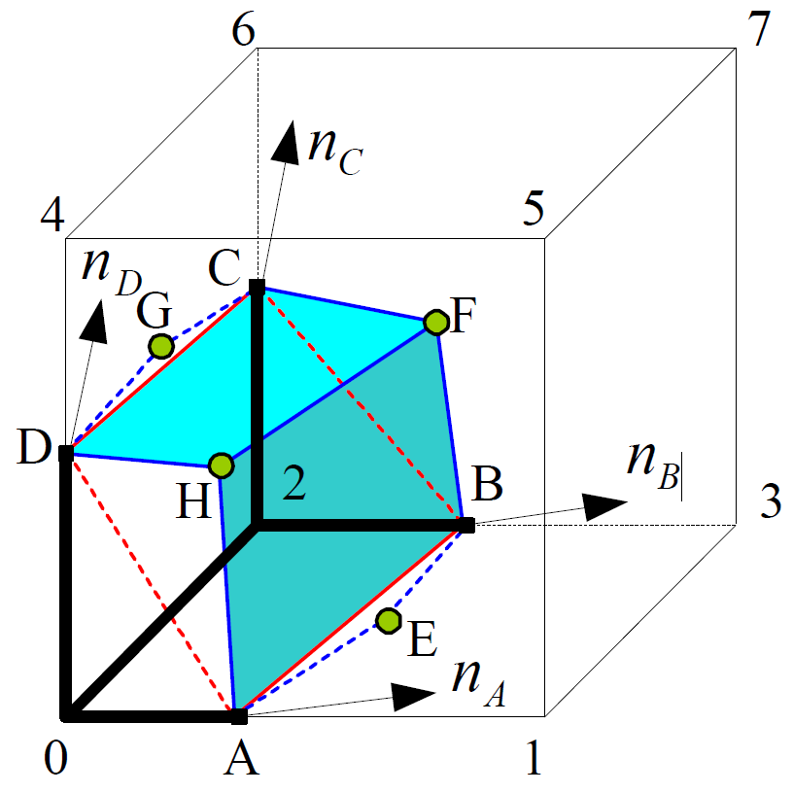
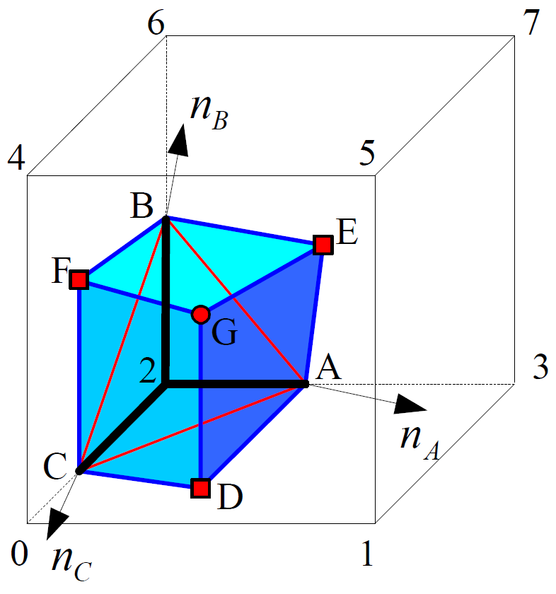
Tri-dexel features
Yongfu Ren et al., Feature conservation and conversion of Tri-dexel volumetric models to polyhedral surface models for product prototyping, 2008

Slide 29
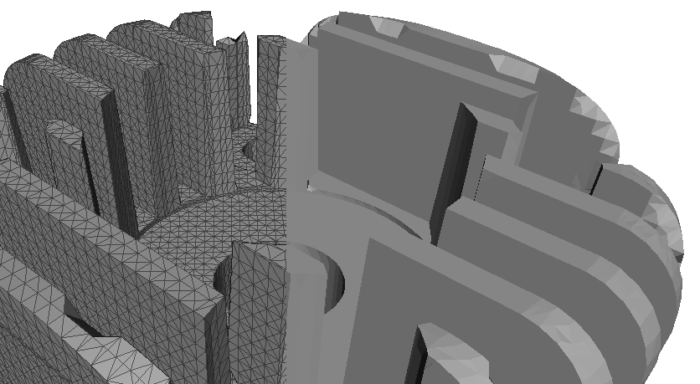
Cylinder head
Without feature reconstruction
With feature reconstruction

Slide 30
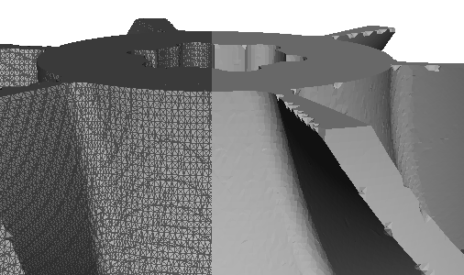
Impeller
Without feature reconstruction
With feature reconstruction

Slide 31
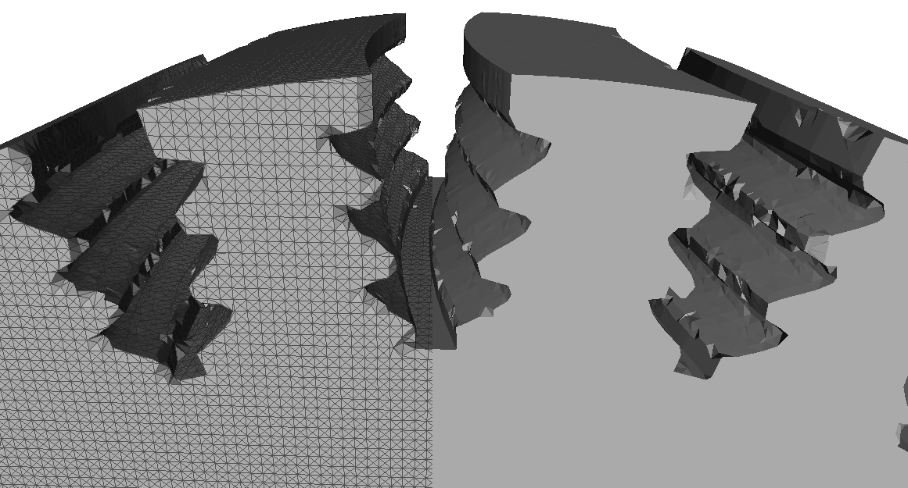
Turbine wheel
Without feature reconstruction
With feature reconstruction

Slide 32
Conclusion
Ball pivoting algorithm
Tri-dexel
Perfectly captures convex features
Completely looses concave features (ball size)
bend triangles according to attached normal (work in progress)
May create holes and role inside
Good reconstruction of larger convex/concave features
Completely looses thin features
on demand subdivision (work in progress)
Embarrassingly parallel

Slide 33
Thank you!
Questions?

